Slide 1
Low Power Embedded FWIRE System Using Integrate-and-Fire
By Nicholas Wulf

Slide 2
What Is FWIRE?
Stands for Florida Wireless Implantable Recording Electrodes
Currently being developed by the Computational NeuroEngineering Lab (CNEL) here at UF
Implanted under the skin
  Invasive enough to analyze individual neurons
  Wireless & small so it’s better than other invasive methods

Slide 3

Why Study the Brain?
Enables neurotechnologies for curing neurological disorders
  Movement disabilities
  Epilepsy
  Spinal cord injury
  Stroke

Slide 4
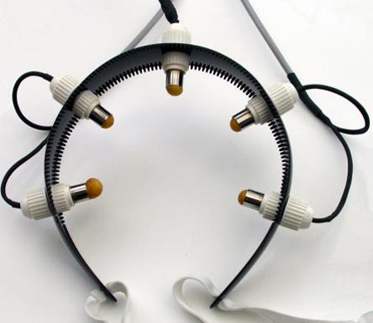
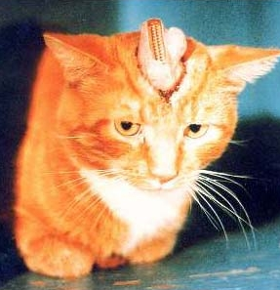
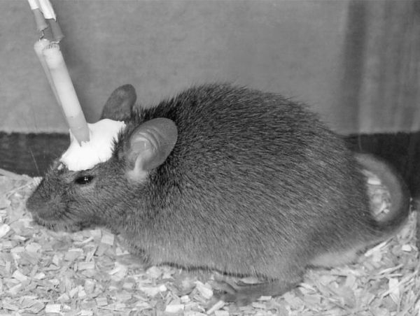
Invasive Vs. Noninvasive
Noninvasive
  No surgery (easy implementation)
  Provides broad view of signal activity (unable to isolate individual neurons)
Invasive
  Gives high resolution image of neurons and their signals
  Requires surgery
  Usually results in cranial obtrusion
    May become infected
    Animals may pick at it
    May limit movement and thus behavior

Slide 5
FWIRE Goals
No tether or external devices strapped to the body
16 channels at 7-bit, 20kHz (effective) sampling
  140 Kbits/s for single channel
  Need a method for transmitting < 500 Kbits/s
< 2 mW of total power dissipation to record, amplify, encode, and transmit wirelessly
  Helps with battery life
  Prevents tissue damage
72-96 hours of battery powered behavior experiments
Area constraint of < 1cm²

Slide 6
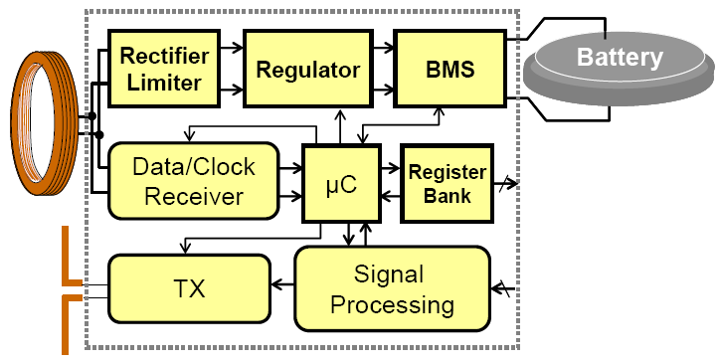
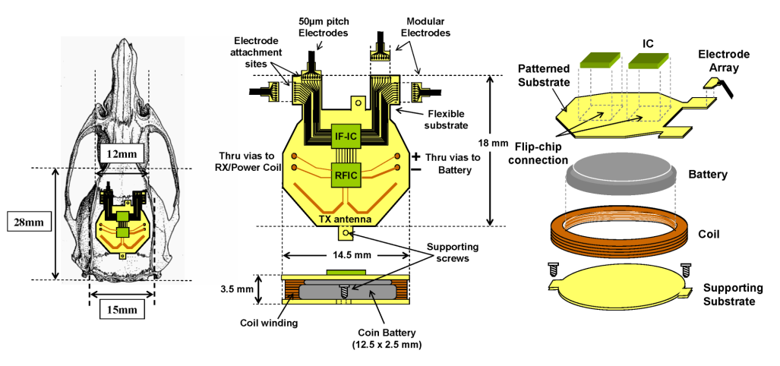
FWIRE System
Modular Electrodes
Tx/Rx capabilities
Rechargeable Li battery with inductive charging
Low power signal amplifier
  Filters out 1-2V DC offsets
  Passes 50uV signals as low as 7Hz

Slide 7
Integrate-and-Fire (IF)
Neuron Model Encoding
Recorded neural action potentials
  The brain is a noisy environment
  Uses as little power as possible
  Solution: Encode signal in spikes!
Let’s steal what nature does well and apply it to our own purposes
Encoding equation
t0
1
2
3
4
5
6
7
8
9
10
11
time

Slide 8
IF Example (Biphasic Pulse Representation)

Slide 9
Why use IF
Advantages
  Pulses are noise robust and efficiently transmitted at low bandwidth
  Front-end is extremely simple
    No conventional ADC required
  Reduces power, bandwidth, and size
Disadvantages
  Back-end requires sophisticated reconstruction algorithm

Slide 10
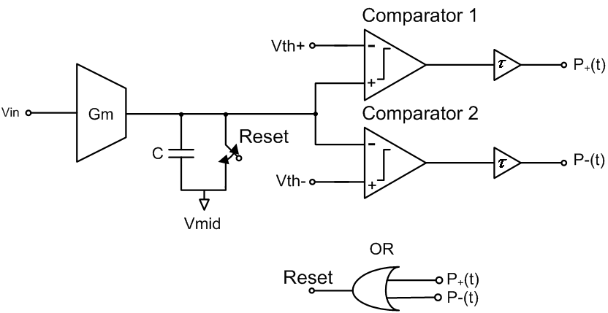
Schematic of Biphasic Encoder

Slide 11
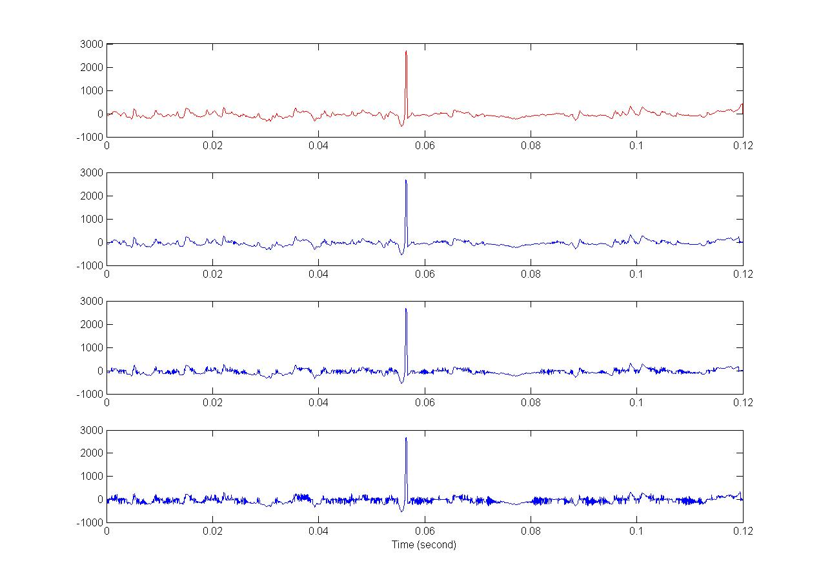
Sub-Nyquist Compression
Original Signal at 25 KHz
Recovered Signal
w/ 17.8 Kpulses/s
Recovered Signal
w/ 9.2 Kpulses/s
Recovered Signal
w/ 6.1 Kpulses/s

Slide 12
Conclusion
Integrate-and-Fire is a great technique for transmitting a signal when the front-end demands low power & simplicity while the back-end is relatively unconstrained

